Slide 1


How to really use Google Gemini 1.5

Slide 2

Exploring the interface

Slide 3
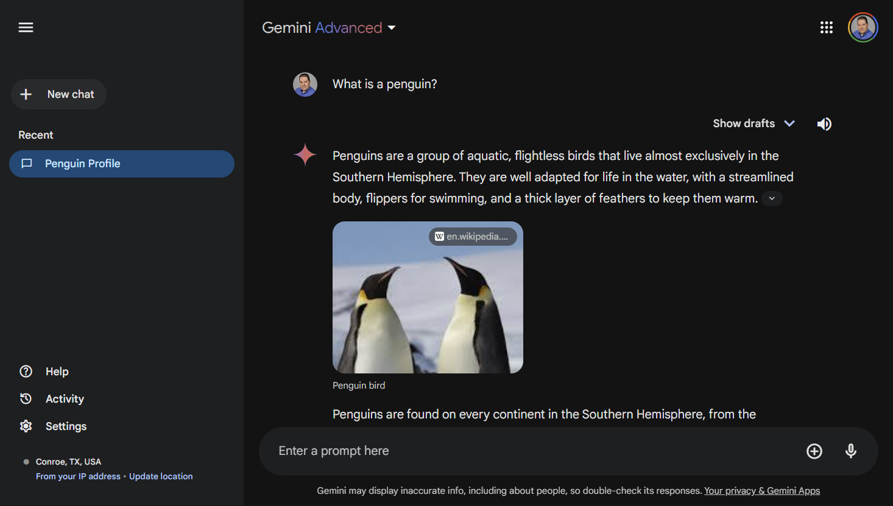

Slide 4

speed
Notes:
Give me a 500 word essay on space-time

Slide 5
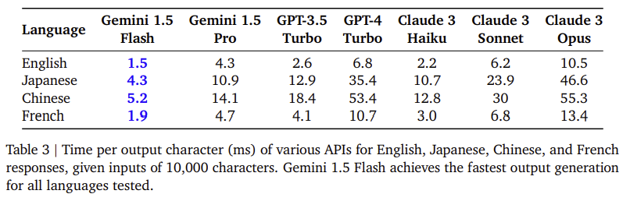
Speed comparison
Notes:
https://storage.googleapis.com/deepmind-media/gemini/gemini_v1_5_report.pdf

Slide 6


